Slide 1

Ergonomics Semester 2 Week 5

Slide 2
What had been discussed last week
Continue working on moment
Check the key difference between ergonomic cumulative and non-cumulative damage assessment

Slide 3
Timeline
Content | Date | Progress
Learning Basics of Deep Learning | Sep 2022 | Done
Installing Alphapose/Openpose/VideoPose3D | Sep-Oct 2022 | Done
Learning Ergonomics Basics | Oct-Nov 2022 | Done
Forming a Framework of Time Continuous Cumulative Fatigue
Preparing for Final Exam | Nov-Dec 2022 | Done
Review the Time Continuous Cumulative Fatigue Framework | Dec 2022 | Done
Trying to Extract Coordinates Using Alphapose/Openpose | Dec 2022
Adding on a Cumulative Fatigue Assessment using Alphapose/Openpose with Python | Jan-Mar 2023
Writing a Technical Report for our Research | Mar 2023

Slide 4
Non- Cumulative Damage Assessment
Repetition 1
Repetition 2
Look at 1 Activity
9 Repetitions
REBA / RULA
Risk Score For This Activity
Repetition 9

Slide 5
Cumulative Damage Assessment
Repetition 1
Look at 1st Repetition
Stress during That Repetition
Damage per Repetition
x 1 Repetition
Cumulative Damage at 1st Repetition
Risk % for This Repetition
When the worker did 2 repetitions
Repetition 2
Cumulative Damage at 2nd Repetition
Look at 2nd Repetition
Stress during That Repetition
Damage per Repetition
x 1 Repetition
Risk % for This Repetition
Cumulative Damage at 1st Repetition

Slide 6
Comparison
REBA/ RULA | Our Method
Time Discrete | Time Discrete
Assess Risk for Each Activity | Assess Risk for Each Repetition
Indirect Repetition | Dynamic Damage per Repetition
No Knowledge of Fatigue | Can Estimate Endurance Limit
No Risk % | Have Risk %
1st Repetition
DPC 1
2nd Repetition
DPC 1
DPC 2
Average DPC
Endurance Limit

Slide 7
Conclusion
Non-cumulative damage assessments only focus on the risk of each activity, however, cumulative damage assessments focus on the risk of each repetition.
The consideration of repetition in non-cumulative damage assessments is indirect because they do not have any equation takes repetition into account but only included in ‘activity score’ by adding 1 mark if the activity is repetitive.
Non-cumulative damage assessments cannot estimate the number of cycles that lead to fatigue, but cumulative damage assessments can.
Non-cumulative damage assessments doesn’t have the indicator that is as detailed as the risk possibility in cumulative damage assessments.

Slide 8
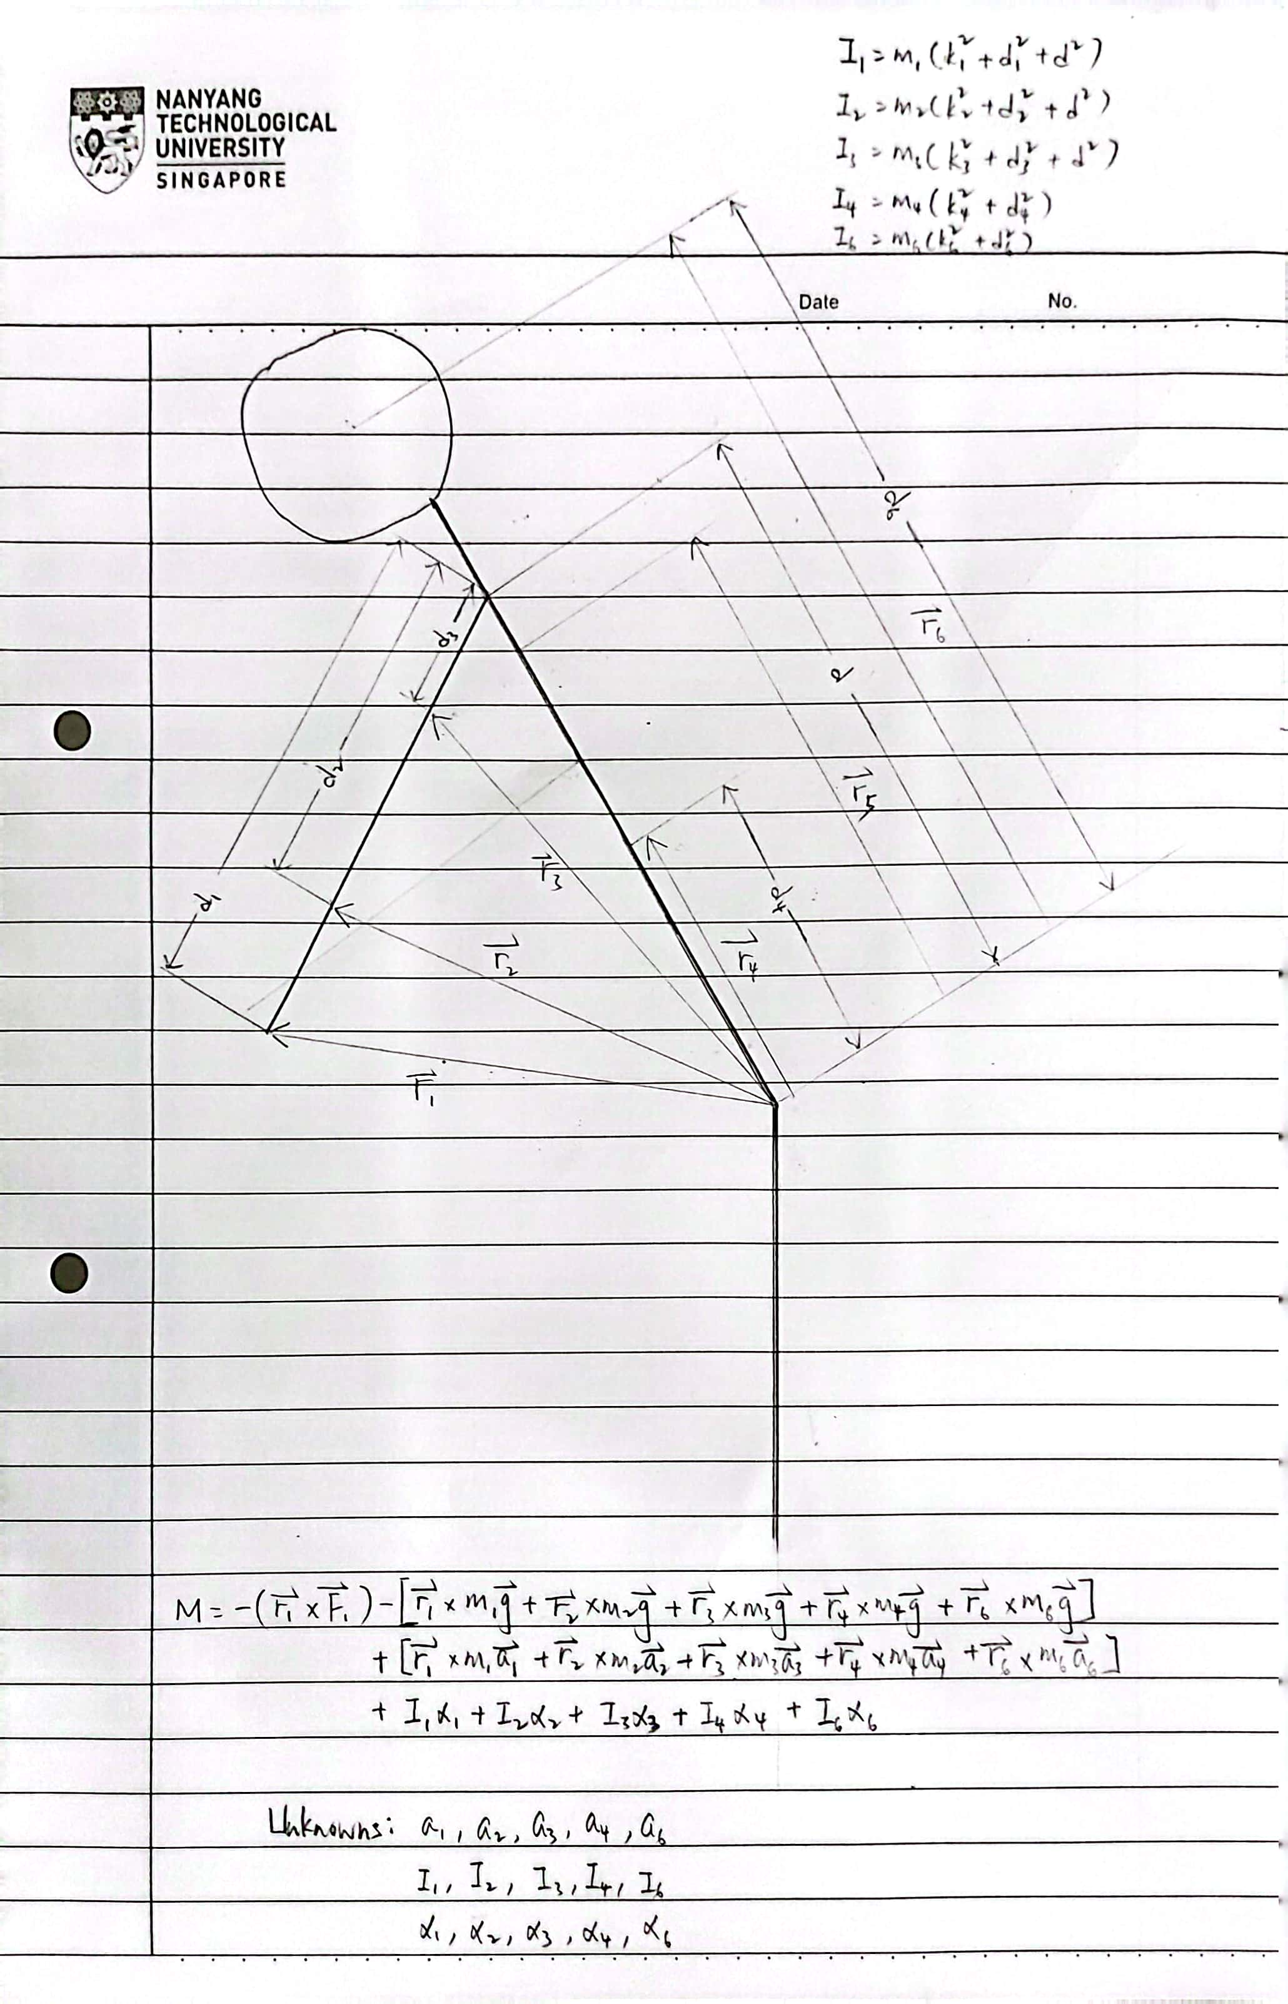
VideoPose3D
Moment is challenging: 1. Moment of Inertia
2. Angular Acceleration
3. Acceleration

Slide 9
Challenges of This Week
Still cannot interpret the dataset that I found before.
The moment calculation is quite tedious, theoretically know how to calculate moment of inertia but still haven’t tried out, and need to find out how to calculate angular acceleration and linear acceleration.

Slide 10
Next Meeting
Design the algorithm to handle moment of inertia, angular acceleration, and linear acceleration
Keep looking for available dataset with 3D ground truth and video data
Next week’s meeting can we change to Wednesday due to CA

